Slide 1
A Comparative Study on Fake Job Post Prediction Using Different Data mining Techniques
By Sultana Umme Habiba, Md. Khairul Islam, Farzana Tasnim
Roll no: 20K-0374 Name Hira Tahir

Slide 2
Objective of the Paper:
The main goal of this research is to address the growing concern of job scam detection. The paper aims to analyze the impacts of fraudulent job posts and contribute to the research field by tackling the challenges associated with detecting such posts. The primary focus is on predicting fake job posts using both traditional machine learning algorithms and a deep learning model.

Slide 3
Data Mining Techniques:
The paper employs various data mining techniques to achieve its objective. The techniques include traditional machine learning algorithms such as Decision_tree, Random_forest, SVM, Logistic Regression and a Deep learning model, specifically a Deep Neural Network (DNN).

Slide 4
Datasets:
The study utilizes the EMSCAD dataset for experimentation, which contains real-life examples of fake job posts. The dataset is processed using Google Colab. For conventional machine learning algorithms, hold-out cross-validation is employed, with 80% of the data used for training and 20% for testing. Specific details are provided for the KNN model, where a range of K values is explored. For the DNN model, a 10-fold cross-validation approach is used, with 60% for training, 20% for validation, and 20% for testing.

Slide 5
LIBRARIES
PANDAS
NUMPY
SEABORN
SKLEARN
WORDCLOUD
NLTK

Slide 6
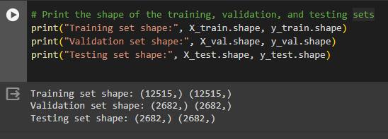
STEP 1: Data cleaning and handling the missing values.
STEP 2: Split the dataset into training, validation, and testing sets.

Slide 7
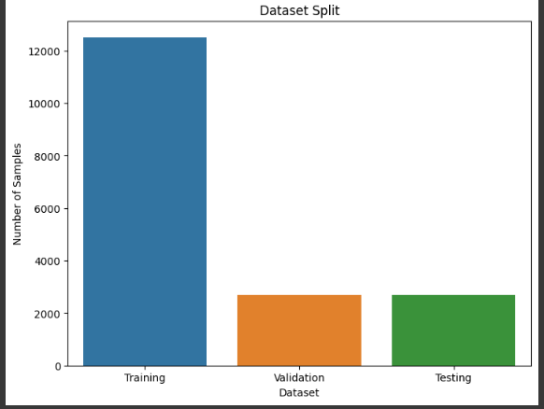
Data Split:

Slide 8

STEP 3: Generate Word Clouds of Legit and Fake Job Postings.

Slide 9
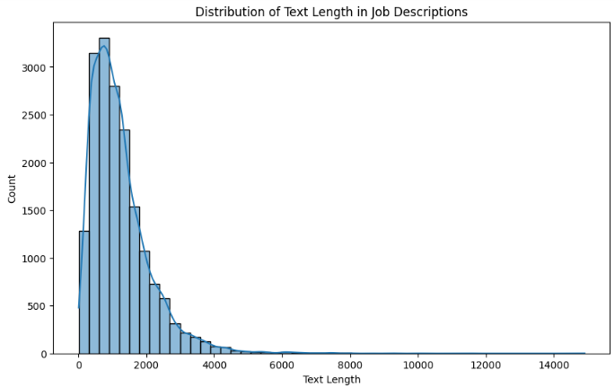
Distribution of text lengths in job descriptions

Slide 10
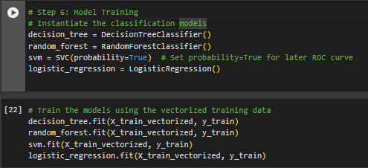
STEP 4: Feature extraction using the Term Frequency-Inverse Document Frequency (TF-IDF) vectorizer.
STEP 5: Train the
Model.

Slide 11
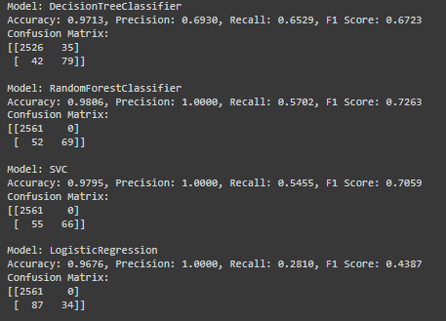
STEP 6: Model
Evaluation

Slide 12
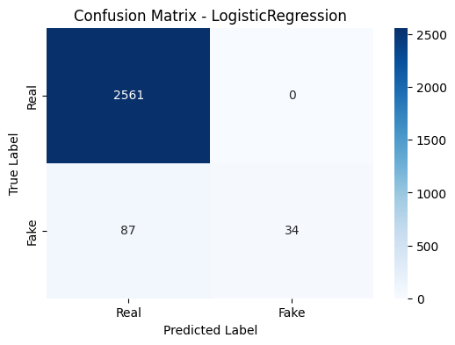
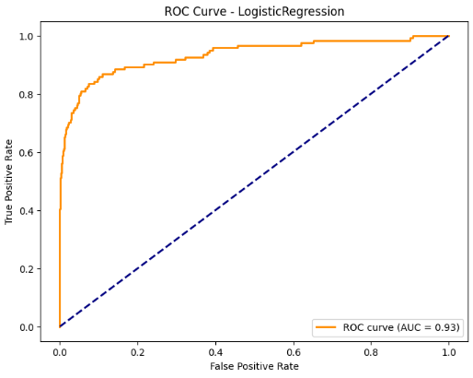
ROC-CURVE: Logistic Regression

Slide 13
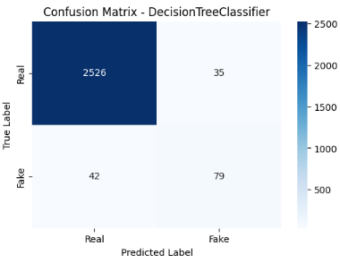
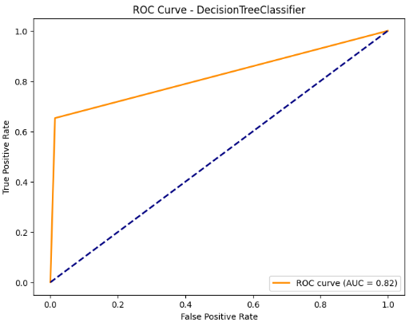
Decision Tree Classifier

Slide 14

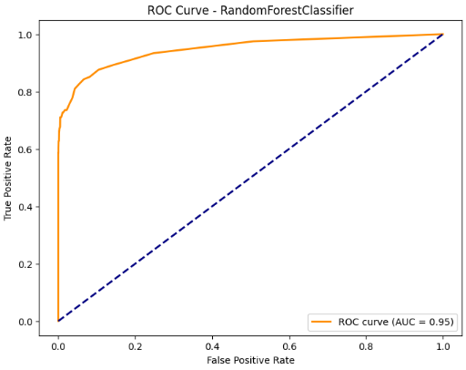
Random Forest Classifier

Slide 15
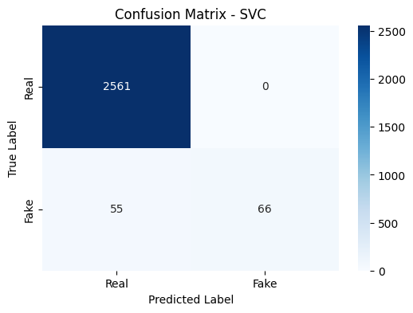
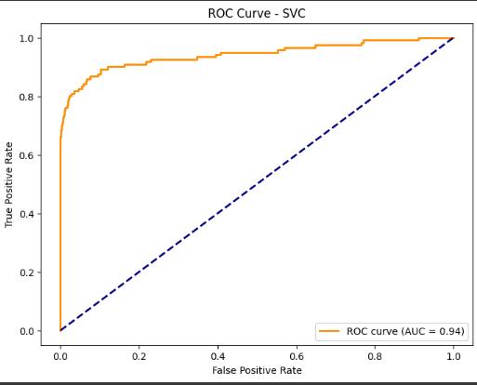
SVC

Slide 16
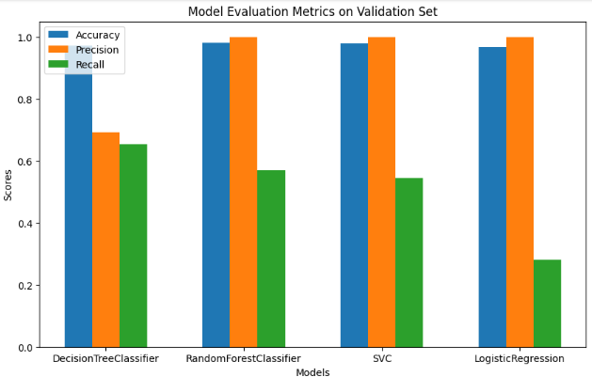
Model Evaluation

Slide 17

Model Evaluation on test set

Slide 18

Generates word clouds for "Legit Jobs" and "Fake Jobs" based on the text data in the training set.

Slide 19
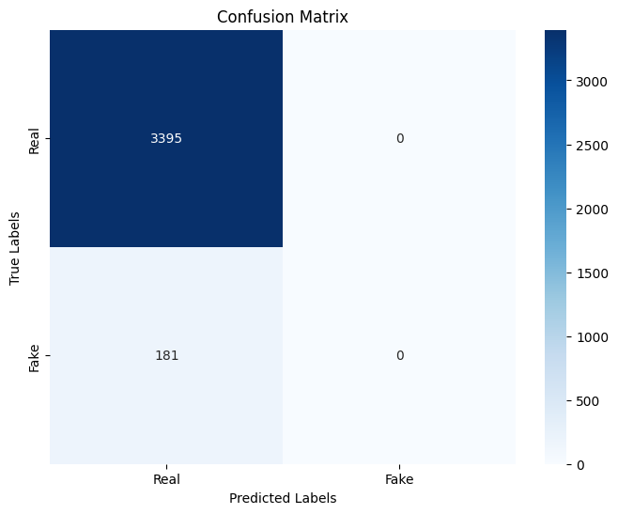
Deep Neural Network (DNN)

Slide 20
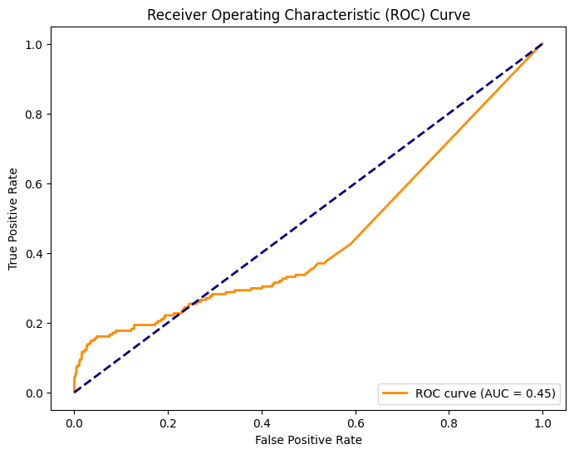
ROC Curve of DNN:

Slide 21
Evaluation Metrics:
The paper evaluates the performance of the models using various metrics. For traditional machine learning algorithms, metrics such as classification accuracy, precision, recall, and F1 score are considered. For the DNN model, accuracy, precision, and recall are analyzed for each fold. The paper emphasizes the importance of assessing the model's performance on a class-imbalanced dataset and considers precision and recall in addition to accuracy.

Slide 22
Results and Findings:
The research reports the highest classification accuracy for the Random Forest Classifier among traditional machine learning algorithms. The DNN model achieves a 99% accuracy for specific folds, with an average classification accuracy of 97.7% across 10 folds. The paper highlights the importance of considering precision and recall, especially in a class-unbalanced dataset.

Slide 23
Challenges and Solutions:
The implementation faces challenges related to the class imbalance in the dataset. The use of precision and recall is emphasized to address this issue. Additionally, a dropout layer is introduced in the DNN model to reduce overfitting and improve generalization.

